Slide 1

SQL Server 2005
Query Plan Caching
C3: Protected

Slide 2

About the Author
Created By: | Vani Majumdar (166081)
Credential Information: | 9+ years of experience as SQL Server DBA
Version and Date: | V 1.0 26-March-2008
Cognizant Certified Official Curriculum

Slide 3









Icons Used
Hands on Exercise
Questions
Tools
Coding Standards
Test Your Understanding
Reference
A Welcome Break
Contacts
Demonstration

Slide 4
Query Plan Caching: Overview
Introduction:
Execution plans that are generated for SQL queries are often cached for reuse. This module gives an insight into how the plan is selected, cached and reused.

Slide 5
Query Plan Caching: Objectives
Objective:
  Understand how SQL Query Optimizer works
  Understand Caching Mechanisms
  Examine Plan Cache
  Understand Plan aging and recompilation
  Understand Parallel Query Processing

Slide 6
Compilation & Optimization
When a query is submitted to SQL Server for processing, it goes through two
phases:
Compilation
Execution
The gap between the two phases can range from seconds to several hours.
Compilation includes:
  Parsing: involves transforming SQL statements to compiler ready data structures and validation of the syntax
  Normalization: involves checking for valid table and column names and checks for semantics
  Compilation of T-SQL code: procedural T-SQL code is compiled
Notes:
Example: it is semantically illogical to execute a table

Slide 7
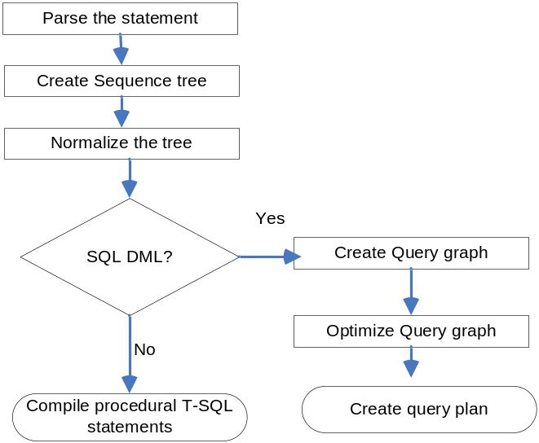
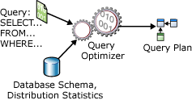
Compilation
During compilation, each statement is parsed and a sequence tree is created
The sequence tree is normalized. Table and column names are verified and metadata for tables and columns are loaded
If DML statements are included, a special structure is created and the optimizer attempts it
A query plan is created
Notes:
Only DML statements can be optimized: Insert, update select, delete

Slide 8
Query Optimizer
SQL Server Query optimizer is a cost based optimizer
  i.e. the optimizer tries to achieve the cheapest execution plan for each statement
Each statement can be executed using several possible paths (or plans)
The optimizer analyzes the statements to achieve the cheapest possible plan (in terms of cost)
The optimizer first performs a trivial plan optimization, if a cheap plan is not available, cost based optimization is performed
Cost based optimizer uses statistical information to come up with a plan
If a cheap plan is not found, then check is made if parallel execution is cheaper
If cost is lesser than parallelism threshold, a full optimization for serial execution is performed
If cost is higher than parallelism threshold, full optimization for parallel execution is performed
Notes:
Every execution plan has a cost associated with it in terms of resources required
Cost does not always translate to resource cost. It works in a way that the results are returned to the client in the shortest possible time using minimal resources
sys.dm_exec_query_optimizer_info - Returns detailed statistics about the operation of the SQL Server query optimizer.
cost threshold for parallelism option is the threshold at which Microsoft SQL Server creates and runs parallel plans for queries. SQL Server creates and runs a parallel plan for a query only when the estimated cost to run a serial plan for the same query is higher than the value set in cost threshold for parallelism
The cost threshold for parallelism option can be set to any value from 0 through 32767. The default value is 5.
It is an advanced option and sp_reconfigure has to be used to change the setting
sp_configure 'show advanced options', 1;
GO
reconfigure;
GO
sp_configure 'cost threshold for parallelism', 10;
GO
reconfigure;
GO

Slide 9
Query Optimizer
The optimizer goes through the following phases
  Query Analysis
  Index Selection
  Join Selection
Query Analysis
  Checks each clause of the query and determines if it can be used as a search argument (SARG)
  SARGs are used to check if the data to be scanned can be limited
  Indexes placed on sargable clauses help in faster retrieval
    E.g. name = ‘smith’
    Deptno >20
    Name = ‘smith’ and salary >40000 etc
    Note: Name LIKE ‘Smi%’ is sargable but not Name LIKE ‘%Smi’
Notes:
Sargable operators are =,>,<,=>,<=, BETWEEN and LIKE

Slide 10
Query Optimizer – Cont’d
Index Selection
  Optimizer looks for indexes placed on a sargable clause
  Selectivity of the index is determined – check to see how many rows are returned
  A covering index is one where the index is on all the referenced columns in the query. This reduces the overhead of accessing the data pages
    PK on EmployeeID, Index on Firstname, LastName, DateofHire
    Select FirstName, LastName, DateofHire From Emp Where EmployeeID = 5
  Statistics are used to find a potentially useful index
  Statistics are basically a histogram of a sampling of values in an index
  These are created when an index in created on existing values
  A selective index is one where the number of unique values returned is high
Notes:
Histograms are stored in statblob column of sysindexes system table
Auto_create_statistics and Auto_update_statistics database options are turned on by default and maintain the statistics up to date

Slide 11
Query Optimizer – Cont’d
Join Selection
  If the query involves self-join or accesses multiple tables, the optimizer evaluates join selection and the one involving lowest cost is selected
  The three types of join strategies are:
    Nested iteration or nested loops
      Rows from the first table are used to scan (and match) rows from the inner table
      The table with fewer rows is selected as the outer table
      This will reduce the number of scans (on tables/indexes) to be performed
    Merge join
      Used when both join inputs are sorted on the join (merge) column
      Rows from each input are compared and discarded if a match is not found and matched rows are returned
      Requires one pass through each input stack
    Hash join
      Uses two inputs: build input and probe input
      The smaller of the two is the build input
      The build input is used to build a hash bucket
      The probe input is examined if a match exists in the hash bucket

Slide 12
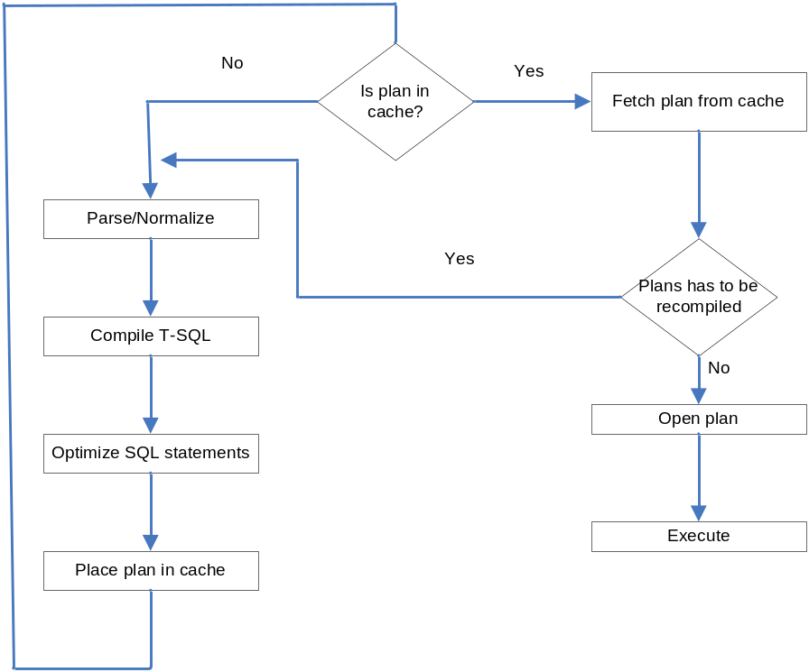
Query Plan
The output of the compilation phase is the Query Plan
This is placed in the Procedure Cache
Not all plans are placed in the cache. For e.g. cheap plans are not cached

Slide 13
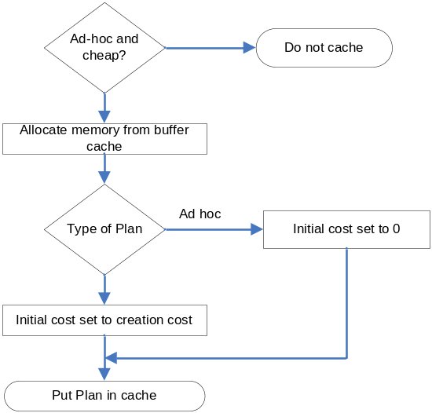
Procedure Cache
Procedure Cache is used to cache compiled and executable plans
It is part of the memory area
The size of the cache is not fixed
When the query is re-executed, the stored plan is used
Plans are saved along with the cost factor
Least used plans are removed from the cache based on the cost. I.e. cheaper plans are discarded
If a plan is reused, the cost is increased. This ensures that an expensive plan is not removed from the cache
Ad-hoc plans remain in cache, if they are executed often

Slide 14
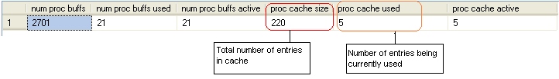
Procedure Cache – Cont’d
Procedure cache entries are at a batch level and stores:
  Compiled Plans
  Execution Plans
  Algebrizer tree
  Extended procedures
DBCC PROCCACHE displays information about procedure cache
DBCC FREEPROCCACHE removes all cached information
  Any statement issued after this will require recompilation, as the plan is no longer in the cache

Slide 15
Caching Mechanisms
SQL Server provides the following mechanisms to cache query plans
  Ad hoc caching
  Autoparameterization
  sp_executesql procedure
  Stored Procedures
    Stored procedures are the most cost-effective caching mechanism

Slide 16
Ad-hoc Caching
Query plans generated from ad hoc queries are cached
If any subsequent batch matches equally, the plan is reused
Mostly limited to exact textual matches
  Example:
  Select * From Employee Where Name = ‘Jones’
  Select * From Employee Where Name = ‘Jane’
  Select * from Employee Where Name = ‘Jane’
  Queries 1 and 2 are compiled and plans are generated
  Query 3 reuses the plan generated by query 2

Slide 17
Autoparameterization
For simple queries where constants are used, SQL Server attempts to use them as parameters and generate a plan
Similar subsequent queries use the same plan
  Example:
  Select Title, Author, Publisher From Books Where TitleID = 20
  Select Title, Author, Publisher From Books Where TitleID = 2
  Internally, the constant is converted to a parameter and the query is parameterized to:
  Select Title, Author, Publisher From Books Where TitleID = @pTitleID

Slide 18
sp_executesql
Queries executed using sp_executesql stored procedure are cached
Parameters should be identified
Syntax:
sp_executesql @batch_text, @batch_parameter_definitions, param1 … paramN
When the batch text is used repeatedly, the cached plan is used
  Example the following use the same plan:
  Exec sp_executesql N’Select FirstName, Title From Employee Where EmpID = @ID’, N’@ID int’, 12
  Exec sp_executesql N’Select FirstName, Title From Employee Where EmpID = @ID’, N’@ID int’, 6
  Exec sp_executesql N’Select FirstName, Title From Employee Where EmpID = @ID’, N’@ID int’, 8

Slide 19
Stored Procedures & Triggers
Stored procedures and triggers offer significant advantage
Only the source of the SP or trigger is stored in the cache
When the SP/trigger is executed for the first time, the source is compiled into an execution plan
On re execution of the same SP, the cached plan is reused
Frequently used SPs are almost never aged from the cache
Notes:
Note: execution plan is not created when the SP is compiled. It is created when it is executed for the first time.

Slide 20
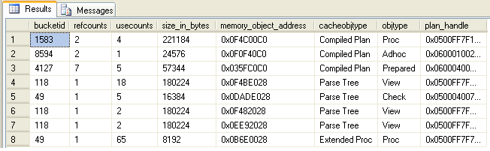
Plan Cache
sys.dm_exec_cached_plans DM View returns information about how the plan cache is used
  usecounts – Number of times the cache object has been used
  cacheobjecttype – could be Compiled Plan, Executable Plan, Parse tree, Extended SP
  Objecttype – could be SP, Prepared statement, Ad hoc query, View, Trigger etc
Notes:
Syscacheobjects system table can also be used. This is present in 2005 for backward compatibility

Slide 21
Parallel Query Processing
For servers having more than one processor, SQL Server allows for parallel processing
Queries that can benefit from parallel execution are identified and the execution plan is optimized for full parallel execution
Uses more than one thread
Degree of Parallelism determines the number of CPUs that are utilized and can be configured
For an individual query, this can be overridden by MAXDOP query hint
Notes:
Available only in enterprise edition
DOP is a server level configurable and is an advanced option

Slide 22
Aging Execution Plans
When additional space is required in the procedure cache, the server removes old and unused plans from the cache
Each query plan is assigned an age field in addition to the cost factor
Each time a query plan is accessed, the age field is incremented
  For e.g. if the cost factor is 8 and the plan is accessed twice, the age field will have a value of 16
The age factor is decremented by the lazywriter by 1 on each scan
  E.g. after 16 scans by the lazywriter, the age of the query plan comes down to zero
The plan is removed from the cache if:
  Memory manager requires memory
  Age is zero for the object
  Object is not used in any connection
Notes:
Even if objects are marked for deallocation, it is done only when more memory is required

Slide 23
Recompiling Execution Plans
Database changes sometime force the execution plans to be recompiled
The server detects these changes and forces the plan to be recompiled
The changes could be :
  Change in the database object (ALTER TABLE / ALTER VIEW)
  Changes to indexes
  Updates to statistics
  Explicit call to sp_recompile
  Bulk inserts/deletes to tables etc.

Slide 24

Questions from participants

Slide 25
Test Your Understanding
Name the steps that are part of compilation phase.
SQL Server optimizer is a ______________ based optimizer.
What is parallelism threshold?
Name and explain the three join strategies.
Output of compilation phase is _____________ which is placed in the ________________
What are the caching mechanisms available in SQL Server?
What is the function of DBCC FREEPROCCACHE?
Plans for Ad-hoc queries are never removed from cache
  True
  False
Name the changes that can cause recompilation of execution plans

Slide 26
Hands-on Exercise
Examine Procedure cache and plan cache
  Use DMVs to examine plan cache

Slide 27
Query Plan Caching: Summary
SQL Query Optimizer is cost based and tries to achieve the cheapest plan
Query processing has two phases
  Compilation
  Execution
Query plans are cached in the procedure cache
SQL Server has the following caching mechansims
  Ad hoc caching
  Autoparameterization
  sp_executesql procedure
  Stored Procedures
Query plans for frequently used queries are not removed from the cache; the age factor increases each time a query plan is used
Database changes such as Alter statements, calls to sp_recompile cause the plans to be recompiled

Slide 28
Query Plan Caching: Source
http://msdn2.microsoft.com/en-us/library/ms175819.aspx
Inside Microsoft® SQL Server™ 2005: Query Tuning and Optimization by Kalen Delaney
Disclaimer: Parts of the content of this course is based on the materials available from the Web sites and books listed above. The materials that can be accessed from linked sites are not maintained by Cognizant Academy and we are not responsible for the contents thereof. All trademarks, service marks, and trade names in this course are the marks of the respective owner(s).

Slide 29
You have successfully completed
Query Plan Caching
Click here to proceed

